Slide 1
Arithmetic Ch 3
CS274
Prof. Ann Marie Schilling

Slide 2
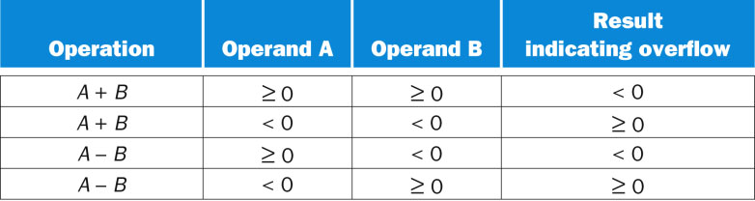
Overflow conditions

Slide 3
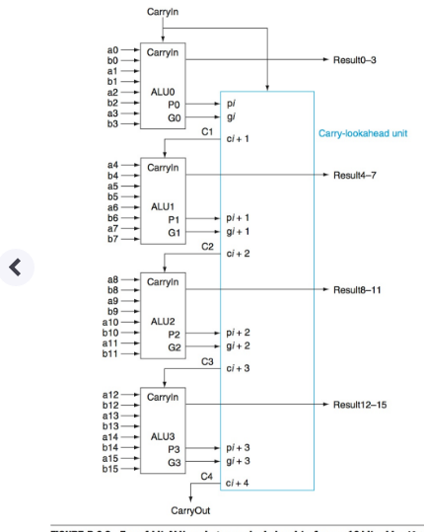
Carry Lookahead Hybrid

Slide 4
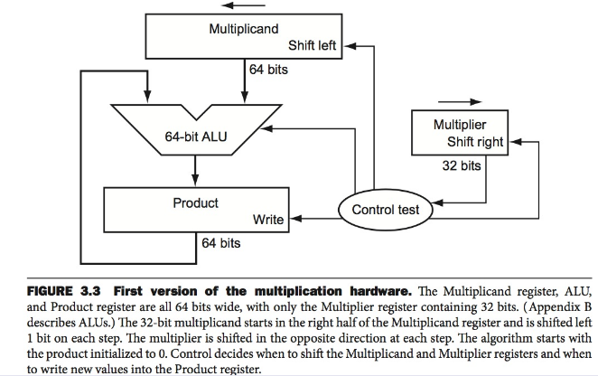
Multiply Hardware

Slide 5
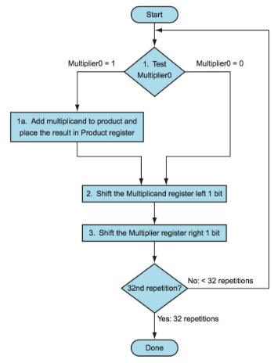
Multiply Flow

Slide 6
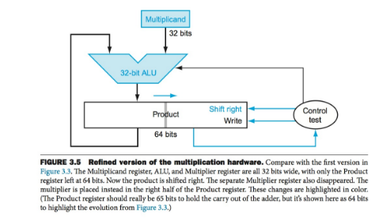
Refined Multiply

Slide 7
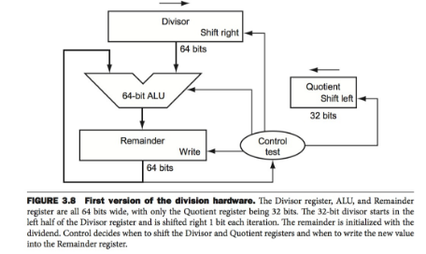
Divide

Slide 8
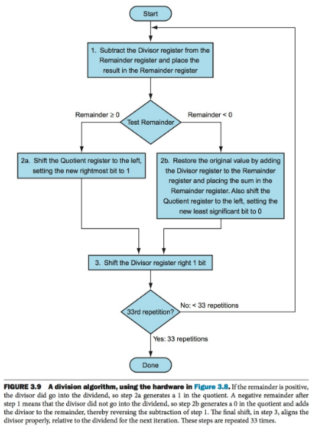
Division Flow

Slide 9
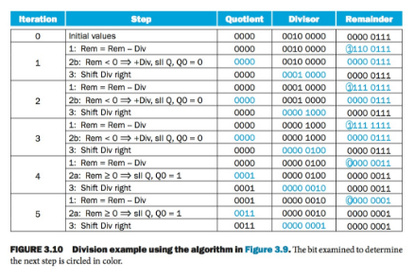
Division Trace

